Slide 1

Spring Boot + ELK Stack Enhancing Application Monitoring and Logging

Slide 2

ELK..?
E => ELASTIC SEARCH
L => LOG STASH
K => KIBANA

Slide 3

Introduction to ELK Stack
1
3
The ELK Stack consists of Elasticsearch, Logstash, and Kibana. This powerful combination provides a robust solution for monitoring and logging applications. Integrating ELK with Spring Boot enhances visibility, enabling developers to analyze application performance and troubleshoot issues eﬀectively.

Slide 4

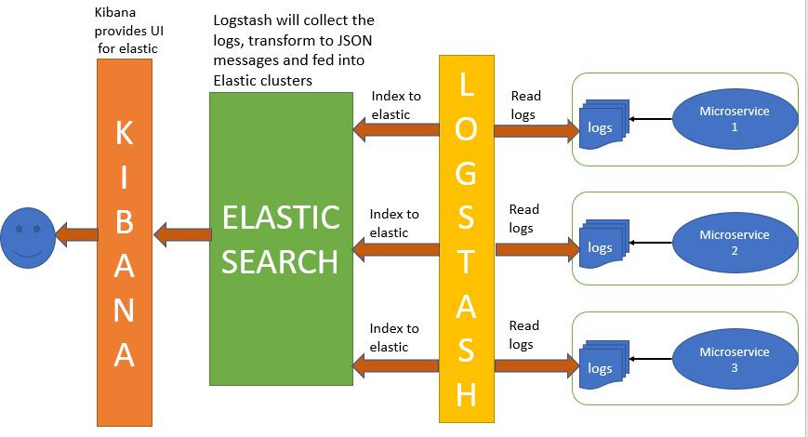
Architecture

Slide 5

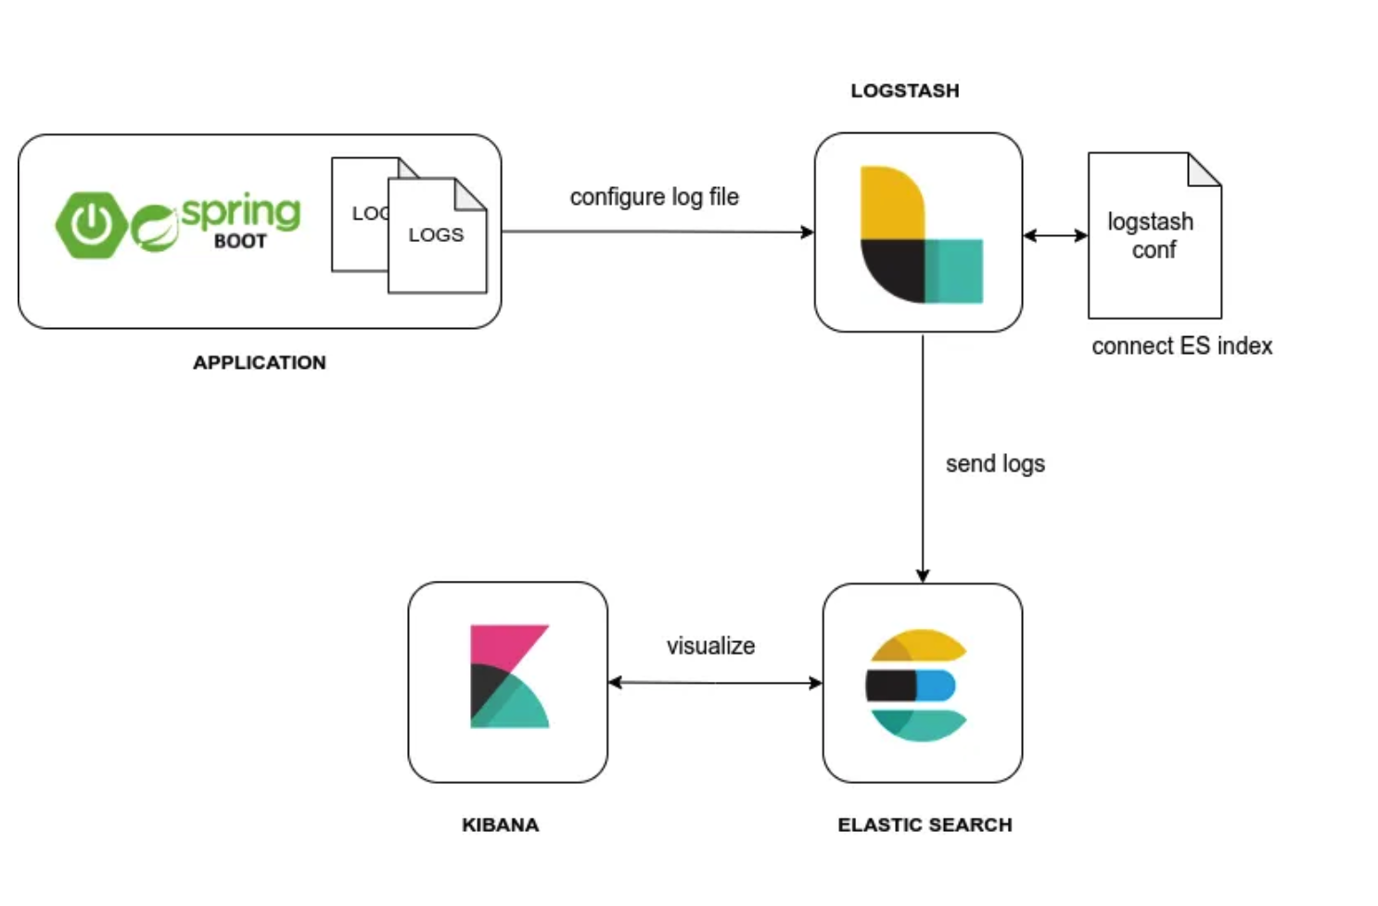

Slide 6
What is Log..?
Example :- 2024-07-28 14:45:10 ERROR com.example.PaymentService - Payment processing failed: orderId=67890, amount=150.00, errorCode=INSUFFICIENT_FUNDS
Breakdown:
Timestamp: 2024-07-28 14:45:10
Log Level: ERROR
Logger Name: com.example.PaymentService
Message: Payment processing failed
Additional Info: orderId=67890, amount=150.00,
ErrorCode=INSUFFICIENT_FUNDS
"log" refers to the recorded data or events generated by applications, systems, or devices. These logs capture important information such as errors, transactions, user activities, and system performance metrics.

Slide 7

Integrating the ELK Stack with Spring Boot oﬀers numerous beneﬁts, including improved log management, enhanced search capabilities, and real-time data visualization. This integration allows developers to gain insights into application behavior, leading to better performance tuning and issue resolution.

Slide 8


Setting Up Elasticsearch
To start integrating the ELK Stack, you ﬁrst need to set up Elasticsearch. This involves installing the software and conﬁguring it to accept logs from your Spring Boot application. Proper conﬁguration is essential for optimal indexing and search performance. (9200)
https://www.elastic.co/downloads/elasticsearch

Slide 9


Configuring Logstash
Next, conﬁgure Logstash to process logs from your Spring Boot application. This includes deﬁning input sources, ﬁlters, and output destinations. Properly setting up Logstash ensures that logs are formatted correctly and sent to Elasticsearch for storage and analysis. (9600)
https://www.elastic.co/downloads/logstash

Slide 10
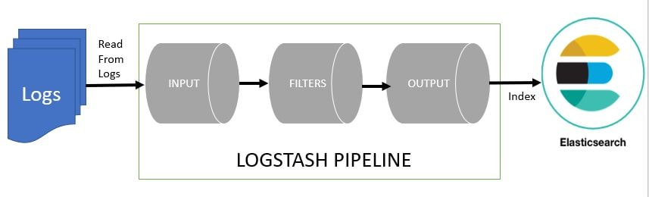
2024-07-28 16:20:30 WARN com.example.OrderService - Order processing delayed: orderId=12345, delay=30min (Log Before LOGSTASH)
{
"@timestamp": "2024-07-28T16:20:30Z",
"log_level": "WARN",
"service": "OrderService",
"message": "Order processing delayed",
"orderId": 12345,
"delay": "30min",
"source": "com.example.OrderService"
}
(Log After LOGSTASH)

Slide 11
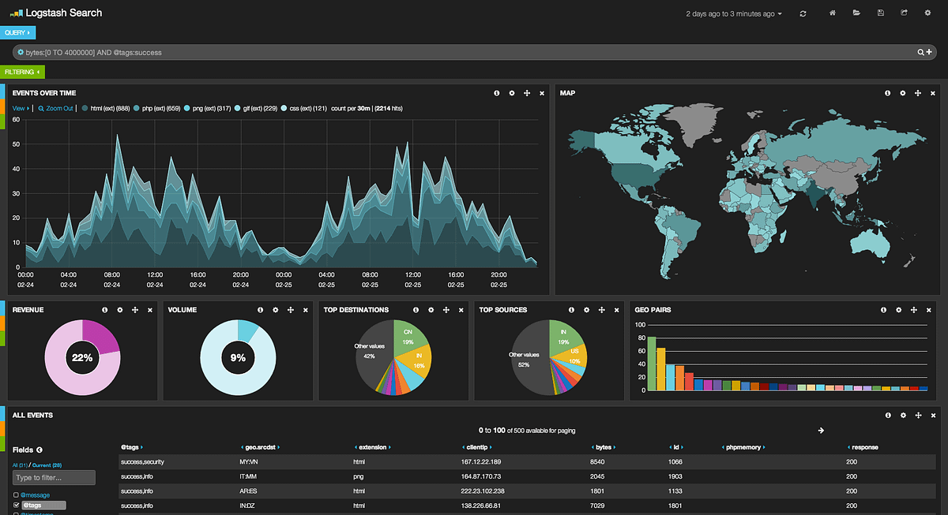
Visualizing Data with Kibana
Once logs are ingested into Elasticsearch, use Kibana to visualize the data. Create dashboards and charts to monitor application metrics in real- time. Kibana's powerful visualization capabilities allow teams to quickly identify trends and anomalies in application behavior.(5601)
https://www.elastic.co/downloads/kibana

Slide 12


In conclusion, integrating the ELK Stack with spring Boot signiﬁcantly enhances application monitoring and logging. Follow best practices like structured logging and regular maintenance to maximize the beneﬁts of this integration. Stay proactive in monitoring to ensure application reliability.
These three projects are used together for log analysis in various environments. So Logstash collects and parses logs, Elastic search indexes and store this information while Kibana provides a UI layer that provide actionable insights.

Slide 13
Thank you.!

